Slide 1
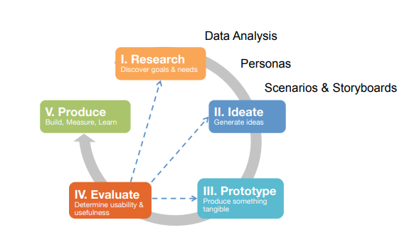

Slide 2
Storytelling
Who are the audiences?
Other designers
Clients
Stakeholders
Managers
Funding agencies
The users
Yourself
Purpose: to provide context
Who will be using the designed product?
Why will they be using it?
What are their goals for it?
Where will the designed product be used?
What do they hope to accomplish?
How does the product fit into their lives?
How does the product make them feel?

Slide 3
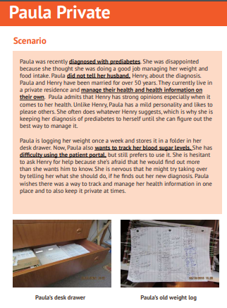
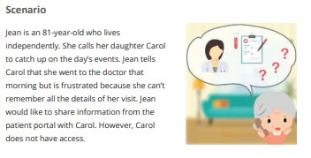
Ways of Storytelling
Written Scenarios
Written accounts and narratives of the experience
- Analogy: Books

Slide 4
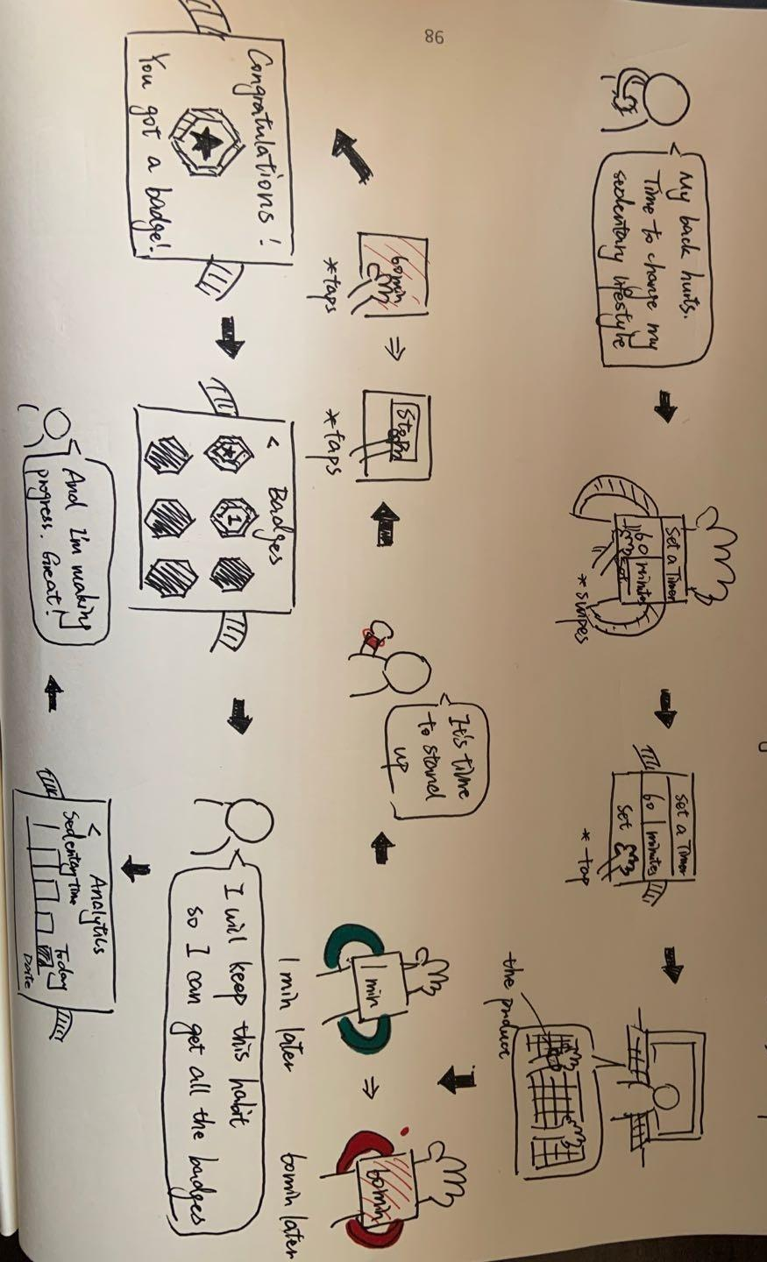
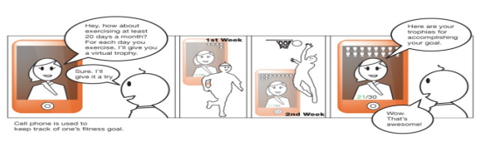
Ways of Storytelling
Storyboards
Visual storytelling with rough sketches/cartoons
- Analogy: Comics, Picture books

Slide 5
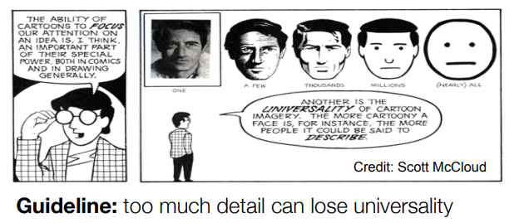
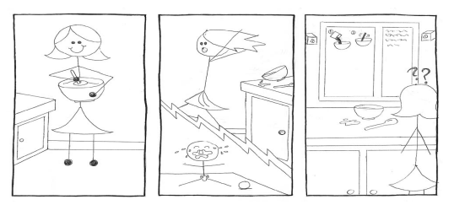
Elements of Storyboard
Level of details
Too much details can lose universality

Slide 6
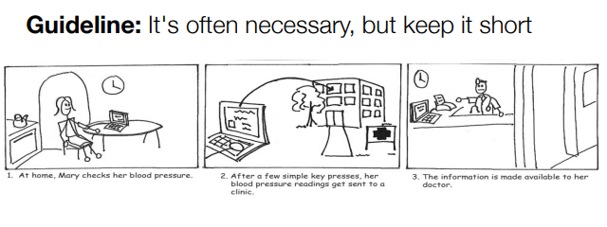
Elements of Storyboard
Use of text
Often necessary, but keep it short

Slide 7
Elements of Storyboard
Include people and emotion
to elaborate their experience with design and their reactions to it, either good or bad

Slide 8
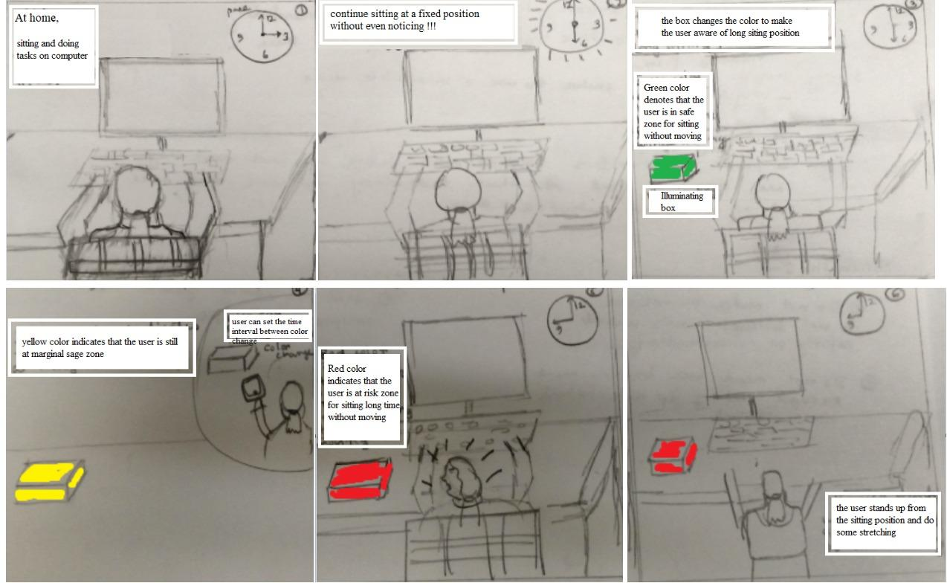
Drawing is Hard…..

Slide 9
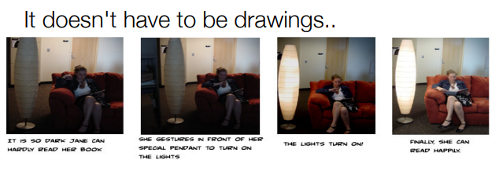
Drawing is Hard…..

